Slide 1
Communication Aptitude Test (CAT)
CAT Overview
April 2026

Slide 2
Communication Aptitude Test (CAT)
Communication Aptitude Test (CAT) started in 2016 supporting one line of business and grew to support 28 LOBs in 2020. A hiring benchmark of 2.2 (CEFR B1) followed by the Talent Acquisition Team in PH and IND.
The CAT Written Assessment was introduced in 2019 and the CAT Chat assessment was added in 2024 to support Non-voice LOBs. In 2024, the CAT Center was established in India to support voice and non-voice hiring.
Question Category
Task
Describe and Instruct
Compare and Contrast
Decide and Justify
CEFR | CAT 3.0
<A1 | < 1.4
A1 | 1.6 – 1.8
A2 | 2.0
B1 | 2.2
B2 | 2.4 – 2.8
C1 | 3.0 – 3.4
C2 | 3.4 >
Description and narration of events or topics
Comparison or Differentiation
Expound on a choice.
Presentation and inference.
Discourse Type
Expected Responses
Description
Narration
Interactive discussion
Short and extended monologue and interaction
Clear and concise
Sequential
Logical

Slide 3
CAT Assessment Structure
Rating Scale | Uses parameters based on language competencies/categories which are arranged on scales corresponding to ability and level.
Voice CAT Segments | 2 PART ASSESSMENT includes a free flow conversation and call simulation Conversation – Participant will be asked to share something about their self. The succeeding questions will be based on what they will share. Job Audition – uses a standardized handout that is user-friendly with highly customizable scenarios that is relevant for all business. Assessments are conducted via Samespace (routing manager)
Non-voice CAT Segments | Job Audition – uses a standardized handout that is user-friendly with highly customizable scenarios that is relevant for all business Email assessments are done via Testmoz (online tool) Chat assessments are done via MS Teams
Form Type | Universal CAT uses a standardized form supporting all businesses. This form is housed in the CAT Ecosystem in Lighthouse and will only have a single form designed for all accounts. A standardized handout is used with highly customized scenarios applicable to any LOB.

Slide 4
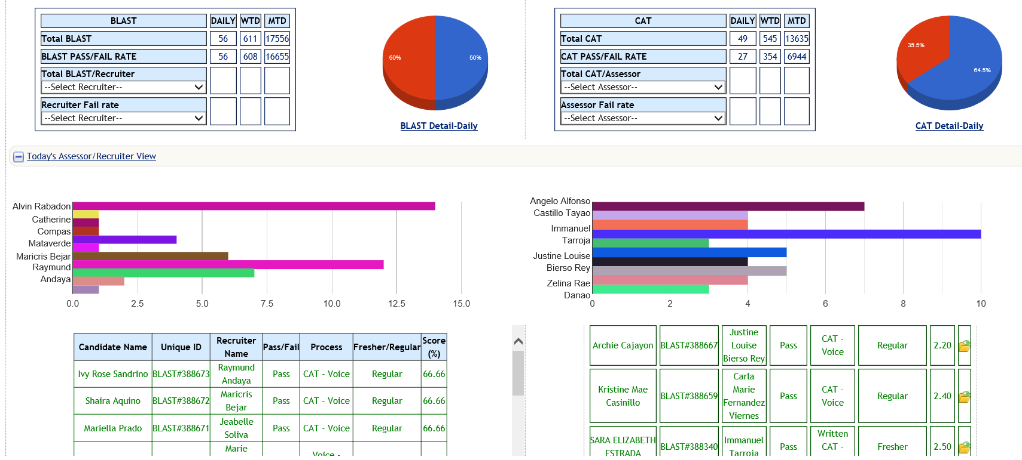

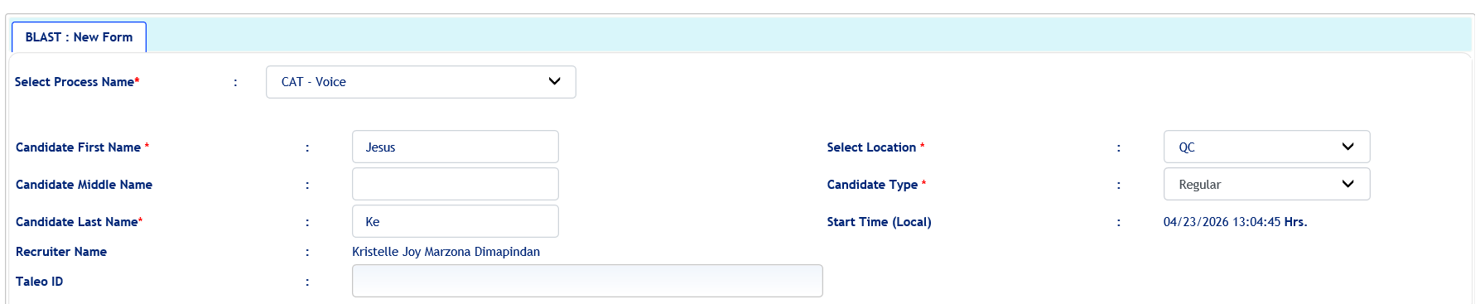
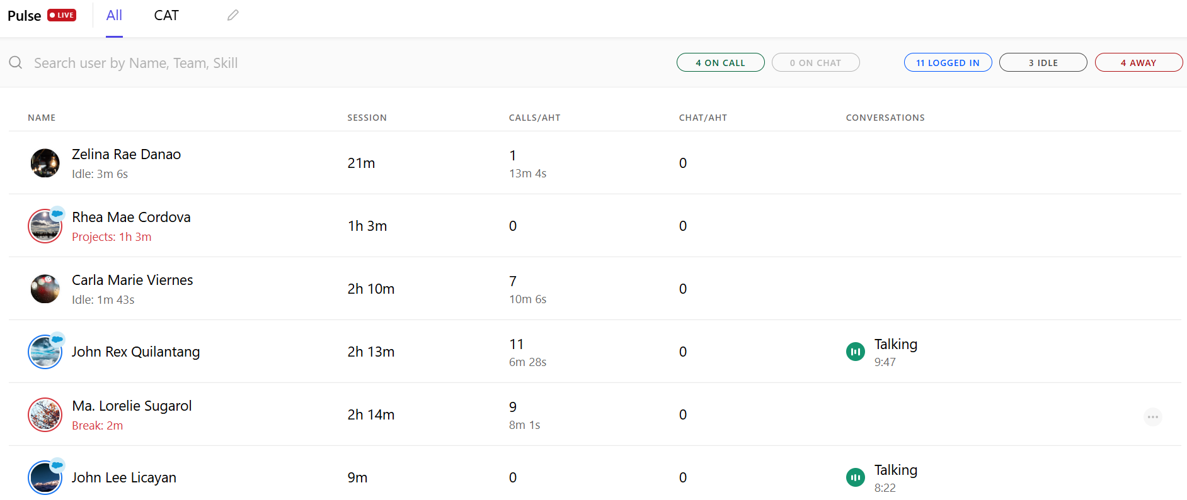

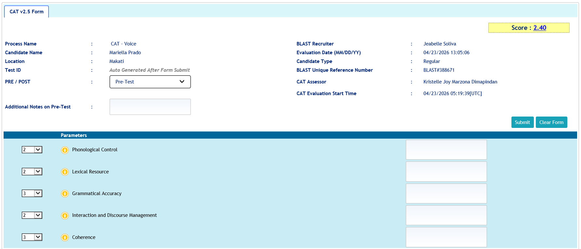
Voice CAT Endorsement Process
Recruiter creates candidate profile to generate BLAST ID via Lighthouse
Candidates with valid BLAST IDs will be endorsed to the CAT Center via Samespace
Results are published real time
Assessment form is accessed via Lighthouse

Slide 5
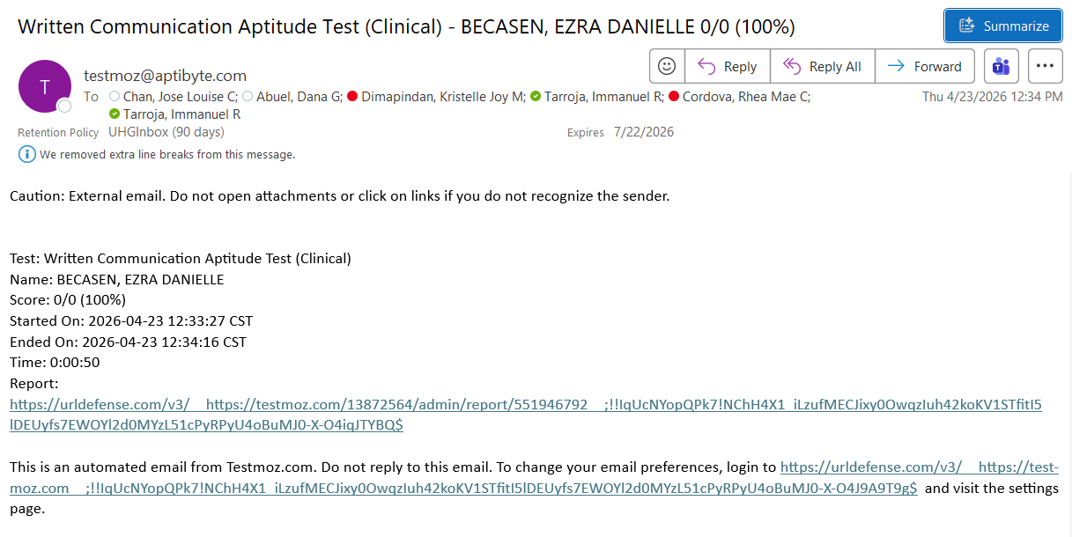
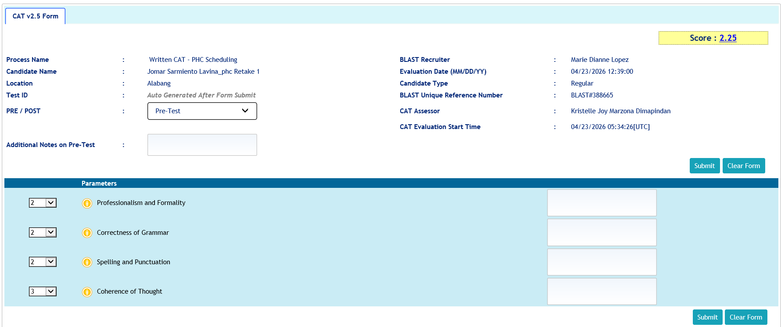
Non-voice CAT Endorsement Process (Email)
Recruiter creates candidate profile to generate BLAST ID via Lighthouse
Candidates with valid BLAST IDs will be endorsed to the CAT Center via Testmoz. CAT assessor will receive an email via Outlook once response was submitted.
Results are published real time
Assessment form is accessed via Lighthouse

Slide 6
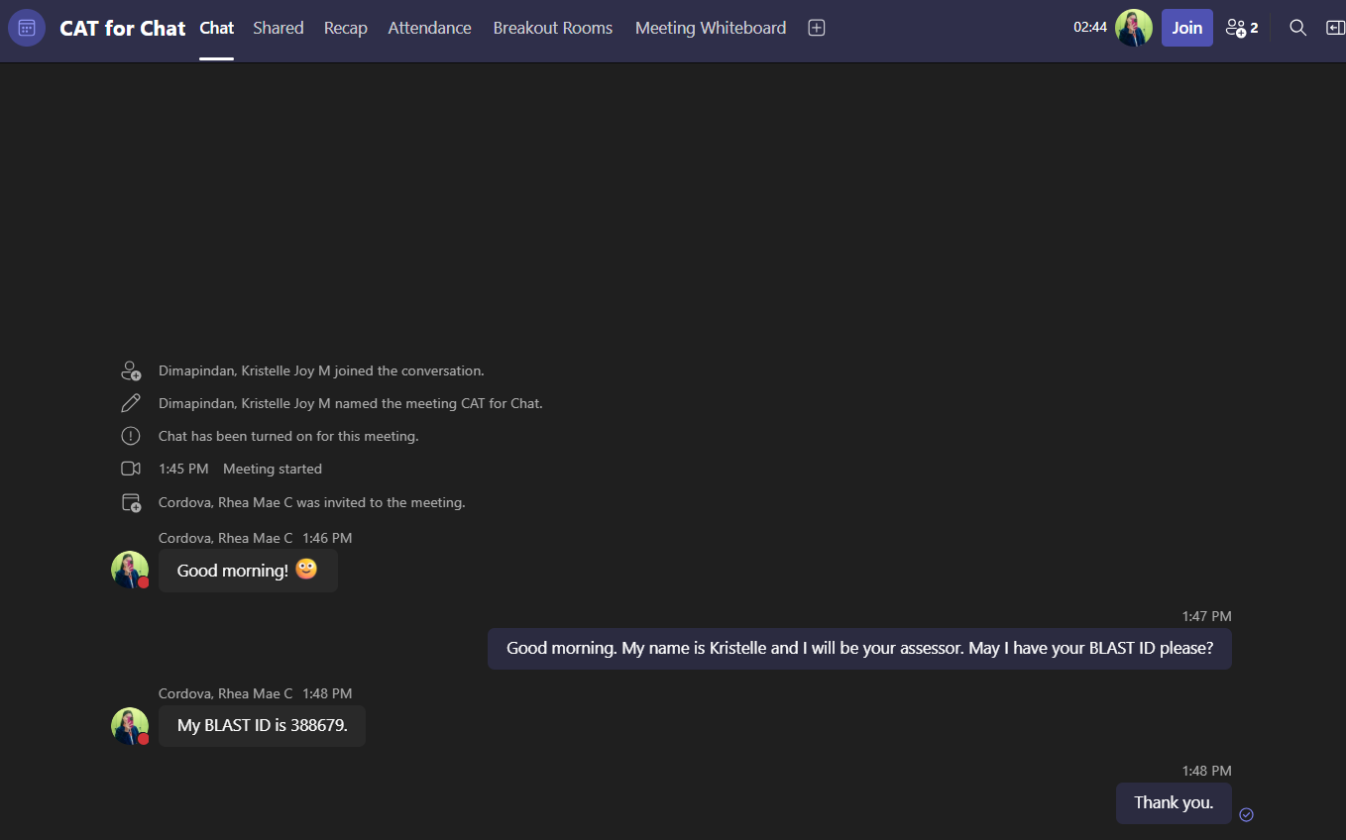
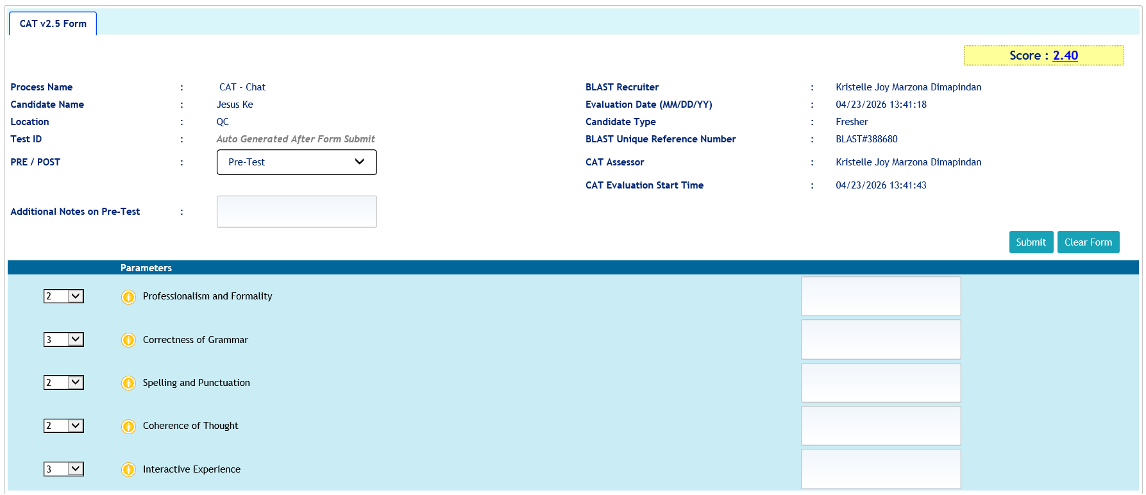
Non-voice CAT Endorsement Process (Chat)
Recruiter creates candidate profile to generate BLAST ID via Lighthouse
Candidates with valid BLAST IDs will be endorsed to the CAT Center via MS Teams. CAT assessors will share a meeting link with TA and will wait for candidate to join
Results are published real time
Assessment form is accessed via Lighthouse

Slide 7





Member Information
Dependent’s Information
Additional Resources
Member Name:
No.
Name
Date of Birth
Relation
Contact No.
Date of Birth:
1
Request for Letter of Authorization
Phone Number:
(814) 733-5456
2
Home Address:
1775 John McClane Avenue
Manifold, CA 92405
Collect the following information from the requesting party:
*Newly enrolled dependent information will reflect within 24 to 48 hours. Dependent’s HMO card will be delivered within 5 business days.
Emergency Contact:
[Update Needed]
E-mail Address:
[Update Needed]
Member’s Name
Policy Number
E-mail Address
Name of the Facility
Member’s Contact #
Plan Information
Billing Information
Policy Number:
265-747-7
Payment Information
Month
Premium Amount
Status
Top-up Premium
Status
Outstanding Balance
Silver Premium
Credit Card No.
**** **** **** 1457
Plan Type:
Paid
Insurance Provider:
United Healthcare
August
$280.00
-
-
-
*Email and SMS notification will be sent to facility and member, four (4) hours after submission of request.
Active
Membership Status:
Automatic Payment: YES
September
$280.00
Paid
$150.00 (Dental & Vision)
Unpaid
$150.00
05/01/2015
Effective Date:
October
$280.00
Unpaid
$150.00 (Dental & Vision)
Unpaid
$430.00
Accredited Facilities and Clinics
*This member enrolled to Dental and Vision Standalone Benefits on September 1, 202X. An additional $150.00 will be added on top of member’s monthly premium.
MANIFOLD GENERAL HOSPITAL
MIGHTY TEETH DENTAL CARE
How to File a Claim?
Drug & Medication
Submit your claims online at www.uhc.com or fax the following documents to 1-866-308-6294, attention to “Claims Department”:
Claim form with the member’s signature
Supporting medical documentation
Case ID on the cover sheet
Tax ID: 620728634
Tax ID: 235093485
Drug Name
Drug Type
Quantity & Limit
Total Price
Doctors
Dr. Adam L. Nail
Dr. Deena C. Pilgrim
Losartan
Hypertension
30 tabs • 2 tabs per day for 15 days
$12.00
Metformin
Diabetes
60 tabs • 2 tabs per day for 30 days
$10.00
Address
742 Highland Ave.
Manifold, California 92405
4588 Midland Way
Manifold, California 92415
Submit medication order for:
Home Delivery
Store Pick Up
Partner Pharmacies
(909) 881-732
Walgreens
Rite Aid Corporation
Safeway
Costco Pharmacies
Contact No.
(909) 789-558
*For home delivery, please expect medication to be delivered in 24 to 48 hours.
Clinic Hours
8am to 7pm
7am to 7pm

Slide 8



Scenario Mapping Voice CAT
Scenario
Synopsis
Expected Behavior or Skill
Scenario 1: Benefits and Eligibility + Account Update
The member called to check the list of pharmacies covered by her plan. They usually receive their medications through home delivery. However, her husband recently passed, and she would like to explore the store pick up option since she’ll be moving in with her son temporarily.
Empathy
Active Listening and Comprehension
Proper Setting of Expectations, Providing Options
Scenario 2: Bill Inquiry + Dependent Enrollment
The member is calling to complain about a bill she received for $580. She's upset because she just lost her job and still figuring out how to pay all her bills.
Empathy
Active Listening and Comprehension
Clear and Logical Explanation
Scenario 3: Filing a Claim + Benefits and Eligibility
The member called in to complain about the incorrect dosage of her medications. She skipped dinner to pick it up from the pharmacy and she feels it’s extremely inconvenient to have it replaced. She would like to know the process to file a claim.
Empathy
Active Listening and Comprehension
Positive Scripting, Proper Setting of Expectations, Providing Options
Scenario 4: Benefits and Eligibility + Letter of Authorization
Provider called in to confirm if their facility is an accredited UHC partner. He is set to undergo a procedure and was previously advised that it will not be covered. The provider was very upset because their back and forth with the member and UHC was time consuming.
Empathy
Active Listening and Comprehension
Positive Scripting, Proper Setting of Expectations
Scenario 5: Benefits and Eligibility + Deescalation
The member sounded upset because she was charged $20 instead of the usual $10 for her medication. She forgot to order her diabetes medication because she and her family just recently moved to their new home.
Empathy
Active Listening and Comprehension
Clear and Logical Explanation

Slide 9




Voice CAT Parameters
Phonological Control
Lexical Resource
Grammatical Accuracy
Interaction and Discourse Management
Coherence
Pronunciation
Speech Clarity
Pace
Vocabulary
Sentence Structure
Use and Understanding of Idiomatic Expressions
Subject-Verb Agreement
Verb Tenses
Prepositions
Articles
Conversational Skills
Empathy and Rapport
Probing
Critical Thinking and Decision Making
Problem Solving
Positive Scripting
Tone
Comprehension
Logical Presentation of Ideas
Clear and Easy to Follow Instructions
Directness of Responses

Slide 10
Non-voice CAT Parameters
Professionalism and Formality
Correctness of Grammar
Spelling and Punctuation
Coherence of Thought
Timeliness
Capitalization
Appropriate use of acronyms and abbreviations
Use of Jargon
Sentence Structure
Subject-Verb Agreement
Verb Tenses
Prepositions
Articles
Correctness in spelling
Proper Punctuation
Complete and concise correspondence
Correctness and Accuracy of information
Comprehension

Slide 11

Skills Mapping (Voice CAT)
Task
Skill
CAT Measure
US Patient Interaction
English Proficiency
Phonological Control, Lexical Resource, Grammar
Cultural Sensitivity
Use and Understanding of Idioms, Empathy, Rapport Building, Engaging in a Conversation
Lexical Resource, Interaction and Discourse Management
Account Management
Active Listening and Comprehension
Interaction and Discourse Management
Problem Solving
Probing, Critical Thinking and Decision Making
Interaction and Discourse Management
Customer Service
Positive Scripting, Proper Setting of Expectations, Providing Options
Interaction and Discourse Management, Coherence
Account Education
Clear and Logical Explanation, Providing Instructions
Coherence

Slide 12
Skills Mapping (Non-voice CAT)
Task
Skill
CAT Measure
Complete and Accurate Documentation
English Proficiency
Correctness of Grammar
Information Accuracy
Professionalism and Formality, Spelling and Punctuation, Coherence of Thought
Completeness of Documentation
Spelling and Punctuation, Coherence of Thought
Attention to Detail
Professionalism and Formality, Coherence of Thought

